Slide 1
WisTransPortal Usage Statistics May 2020
Wisconsin Traffic Operations and Safety (TOPS) Laboratory
Notes:
1

Slide 2
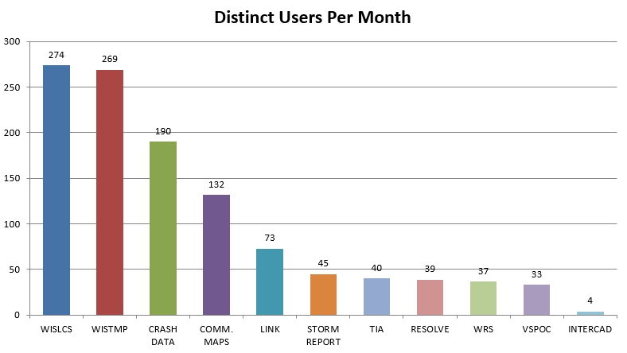
WisTransPortal Applications 2019 Annual - Distinct Users Per Month
Notes:
2

Slide 3
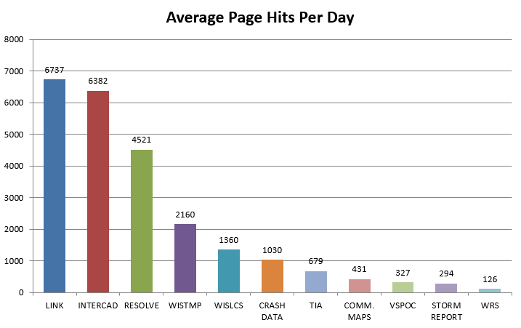
WisTransPortal Applications 2019 Annual - Average Page Hits Per Day
Notes:
3

Slide 4
WisTransPortal Sitewide Authenticated Page Requests
Notes:
4

Slide 5
Wisconsin Lane Closure System
Notes:
5

Slide 6
Wisconsin TMP System
Notes:
6

Slide 7
Crash Data Facility
Notes:
7

Slide 8
Community Maps
Notes:
8

Slide 9
SCM Safety Certification Map
Notes:
9

Slide 10
Crash Database Resolve System
Notes:
10

Slide 11
LINK Agency Video Sharing
Notes:
11

Slide 12
TIA Traffic Incident Alerts
Notes:
12

Slide 13
511 WRS Winter Road Conditions
Notes:
13

Slide 14
Winter Storm Report System
Notes:
14

Slide 15
V-SPOC ATMS Detector Data
Notes:
15

Slide 16
InterCAD Incident Data Exchange
Notes:
16

