Slide 1



Lane Closure System 2.0
Introduction to LCS
You can play the presentation in Slide Show mode with or without the sound on
Notes:
Lane Closure System 2.0
Introduction to LCS

Slide 2
Overview
What is LCS?
Getting Started in LCS
Request Closures
Modify Closures
Search Closures
LCS Resources

Slide 3
What is LCS?
The Wisconsin Lane Closure System (LCS) is a web-based system for tracking closures and restrictions on Wisconsin Interstate, US, and State highways
Provides a standard interface for lane closure operations, closure tracking, and data retrieval for WisDOT regional offices statewide
Improving the completeness, reliability, and timeliness of lane closure data on state highways
All LCS data is archived in the WisTransPortal system for future analysis and integration with other applications and research
Notes:
The Wisconsin Lane Closure System (LCS) is a web-based system for tracking closures and restrictions on Wisconsin Interstate, US, and State highways
To provide a standard interface for lane closure operations, closure tracking, and data retrieval for WisDOT regional offices statewide
To improve the completeness, reliability, and timeliness of lane closure data on state highways
To archive LCS data in the WisTransPortal system for future analysis and integration with other applications and research
To integrate historical traffic flow data and capacity information to calculate available closure thresholds

Slide 4
Benefits of LCS
Coordinates activities to reduce potential conflicts
  Multiple activities can utilize the same closure
  Avoid lane closures during a special events
  Avoid a right lane closure near a left lane closure on the same roadway
Eliminates duplications and inefficiencies by streamlining information into one system
Provides link to historical data that can be used to make informed decisions
Interoperability with the OSOW freight permitting system and the Traffic Management Center ATMS
Notes:
Coordinates activities to reduce back-ups and potential conflicts
Multiple activities can utilize the same closure
Avoid lane closures during a special event
Avoid right lane closure near a left lane closure on the same roadway
Eliminates duplications and inefficiencies by streamlining information into one system
Provides link to historical data that can be used to make informed decisions

Slide 5
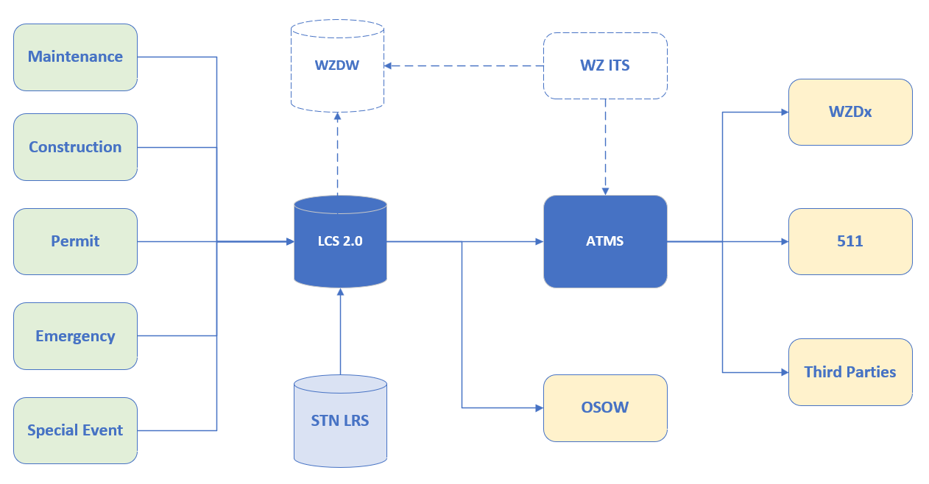
Data Sharing
Wisconsin 511 System
Traffic Management Center (TMC) Advanced Traffic Management System (ATMS)
Work Zone Data Exchange (WZDx)
Third Party (vehicle navigation systems, phone/tablet apps, social media, news)
Superload Permitting System
Notes:
LCS shares data with several mediums:
Wisconsin 511 System
Traffic Management Center (TMC) Advanced Traffic Management System (ATMS)
Work Zone Data Exchange (WZDx)
Third Party services (vehicle navigation systems, phone/tablet apps, social media, news)
Superload Freight Permitting System

Slide 6
What Closures should be Tracked?
All let projects or design projects with impacts to an Interstate, US, or State Highways (Lane/Shoulder closure, Resrictions, Full Closure, etc)
Any planned maintenance or permitted restrictions of closures on Interstates, US or State Highways
Major special events (PGA, Summerfest, Parade, Car Show, Race)
Planned Events (Milwaukee Bucks, Green Bay Packers, Wisconsin Badgers)
Any unplanned, emergency lane closures
Off shoulder work does not need to be entered into LCS
Notes:
All let projects or design projects with impacts to an Interstate, US, and/or State Highway
Any planned maintenance or permitted restrictions of closures on interstates, US highways, and State highways
Major special events
Any unplanned, emergency lane closures
Off shoulder work does not need to be entered into LCS

Slide 7
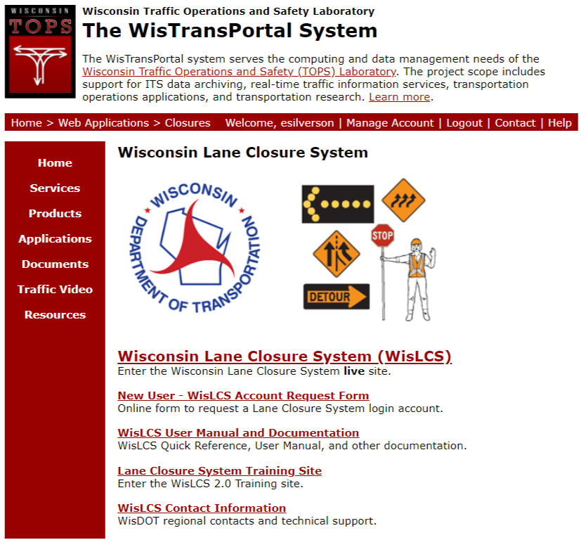
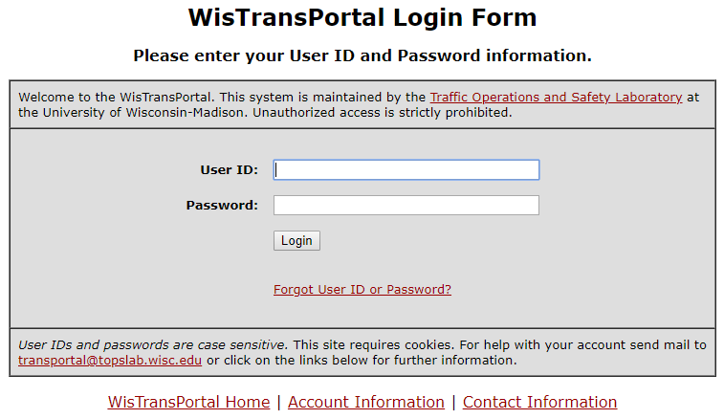
Getting Started in LCS
Logging on: https://transportal.cee.wisc.edu/closures/
New User? Start here
Notes:
Go to the WisTransPortal system and click on the Wisconsin Lane Closure System

Slide 8
User Types
A user may only enter and act upon a closure of the same type as the user's type.
The user type options in LCS include:
  Construction – must have a WisDOT Project ID
  Maintenance – maintenance work required by state/local/county
  Permit – must have a permit number
For example, if a user is entered in the system as ‘Maintenance’, then they can only request Maintenance closures.
Notes:
A user may only enter and act upon a closure of the same type as the user's type.
The user type options in LCS include:
Construction – must have a WisDOT Project ID
Maintenance – maintenance work required by state/county/local
Permit – must have a permit number
For example, if a user is entered in the system as ‘Maintenance’, then they can only request Maintenance closures.

Slide 9
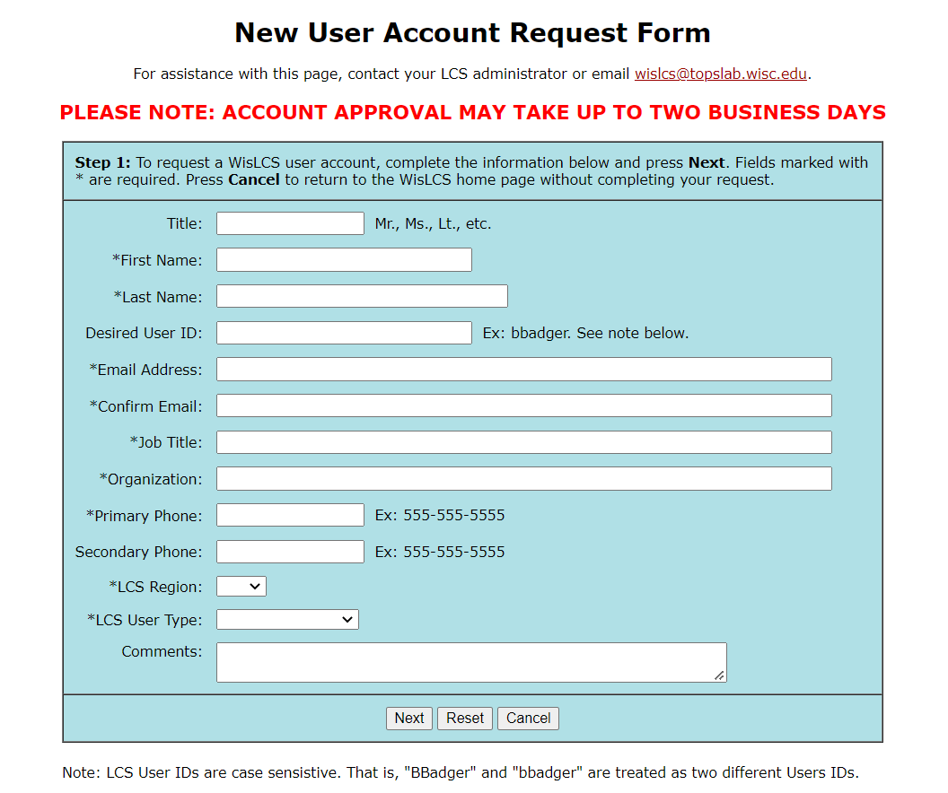
User Account Request
Choose LCS User Type:
Construction
Maintenance
Permit
Notes:
Based on the user types just described, you would select the one that best fits your request, construction, maintenance or permit when requesting access.

Slide 10
User Roles
Standard User (Viewer) - Does not have acceptance authority and does not have access to any interface that allows them to act upon a closure, including requesting, other than to view it.
Requestor - Likely a WisDOT employee, consultant, contractor, utility company, municipality/town/village employee or county maintenance personnel who may only enter or view closures.
Limited Approver - Can create/modify/edit closures. They can accept nonpriority roadway closures.
Full Approver - Can create/modify/edit closures. They can accept nonpriority and priority roadway closures and update project level information.
Regional Manager - Acts as regional coordinator of closures and are typically responsible for accepting closures for the region on Priority Roadways. Can assign acceptance authorization to users and perform other administrative functions and privileges. Essentially, they have full access to the system.
System Manager - Have same functions as Regional Manager but for all regions.
Notes:
Standard User (Viewer) - Does not have acceptance authority and does not have access to any interface that allows them to act upon a closure, including requesting, other than to view it.
Requestor - Likely someone outside of the Department, such as a contractor or county maintenance personnel who may only enter or view closures.
Limited Approver - Can create/modify/edit closures from their Team. They can accept nonpriority roadway closures.
Full Approver - Can create/modify/edit closures from their Team. They can accept nonpriority and priority roadway closures and update project level information.
Regional Manager - Act as regional coordinators of closures and are typically responsible for accepting closures for the region on Priority Roadways.
System Manager - Can assign acceptance authorization to users and perform other administrative functions and privileges. Have same functions as Regional Manager but for all regions.

Slide 11
Closure Types
Work Examples | User Type
Construction Company to perform construction project on state highway (LET Project) | Construction
City/town/village to perform construction project on state highway (connected highway) | Construction
County Highway Dept to perform maintenance work on state highway | Maintenance
City/town/village to perform maintenance work on state highway (connected highway) | Maintenance
City/town/village to close state highway for Special event (race, parade, etc.) | Permit*
Utility Company to conduct utility work on state highway | Permit
Any company working on a state highway with an approved permit | Permit
Construction
Maintenance
Permit
Special Event
Emergency
– flagged
*If entering a special event, first choose permit as a user type and then special event as closure type.
  Flagged means the user must have an access flag to enter emergency closures
Notes:
The various closure types are: construction, maintenance, permit, special event and emergency.
Users must be flagged to have access to enter emergency closures.
Listed are work examples and what user type should submit that type of work.
*If entering a special event, first choose permit as a user type and then special event as closure type.

Slide 12
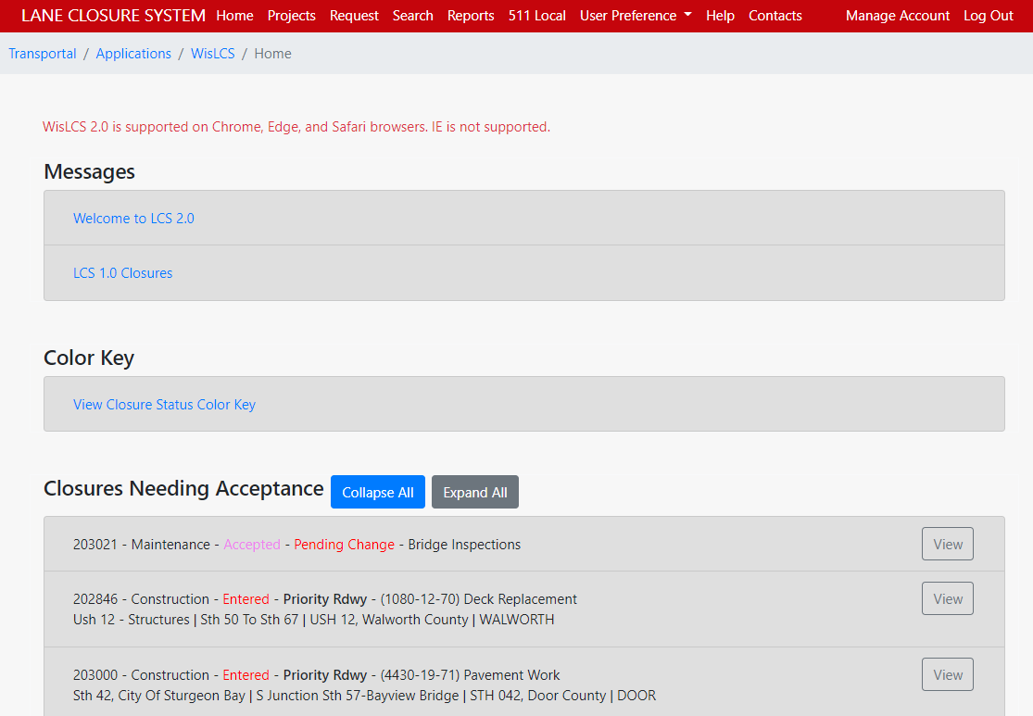
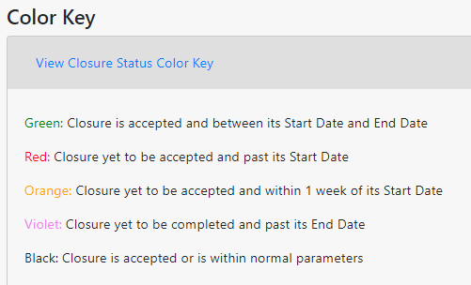
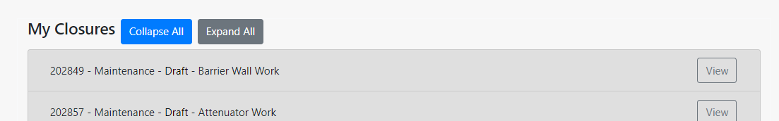
Home Screen
Projects tab only displayed for Construction User Type
Sections vary based on user profile
Closures can be viewed in more detail by clicking View button
Only displayed for Approvers / Regional Managers
Notes:
Shown is the Home Screen.
Sections vary based on user profile
Closures can be viewed in more detail by clicking View button

Slide 13
Requesting a Closure
Adhere to the minimum notification requirements for entering closures
CLOSURE TYPE AND REQUIRED MINIMUM ADVANCE NOTIFICATION
Closure type with height, weight, or width restrictions (available width, all lanes in one direction <16’) | MINIMUM NOTIFICATION
Lane and shoulder closures | 7 calendar days
Full roadway closures | 7 calendar days
Full Ramp closures | 7 calendar days
Detours | 7 calendar days
Closure type without height, weight, or width restrictions (available width, all lanes in one direction ≥16’) | MINIMUM NOTIFICATION
Lane and shoulder closures | 3 business days
Ramp closures | 3 business days
Modifying all closure types | 3 business days
Notes:
Adhere to the minimum notification requirements for entering closures as shown in the table

Slide 14
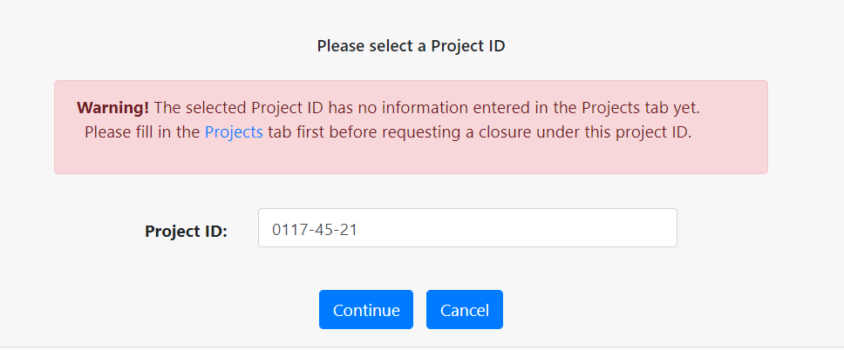
Construction Project Closure
Do you have a WisDOT Project ID for this closure?
  YES: Go to the Request Tab and enter the project ID, click Continue.
  Did the system allow you to start entering a closure?
    YES: Proceed with entering the closure
    NO: If you received a warning that the Project ID is not in the system,
    the next slides will show you how to set up a project
  NO: Determine what type of project this is.
  Is it a maintenance or permit project instead?
    YES: Enter closure as maintenance or permit
    NO: If this is a construction project, but no Project ID is in the system,
    contact the TOPS Lab to add the project to LCS
Notes:
Do you have a WisDOT Project ID for this closure?
YES: Go to the Request Tab and enter the project ID, click Continue. Did the system allow you to start entering a closure?
YES: Proceed with entering the closure
NO: If you received a warning that the Project ID is not in the system, the next slides will show you how to set up a project
NO: Determine what type of project this is. Is it a maintenance or permit project instead?
YES: Enter closure as maintenance or permit
NO: If this is a construction project, but no Project ID is in the system, contact the TOPS Lab to add the project to LCS

Slide 15
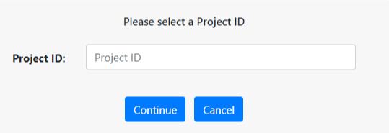
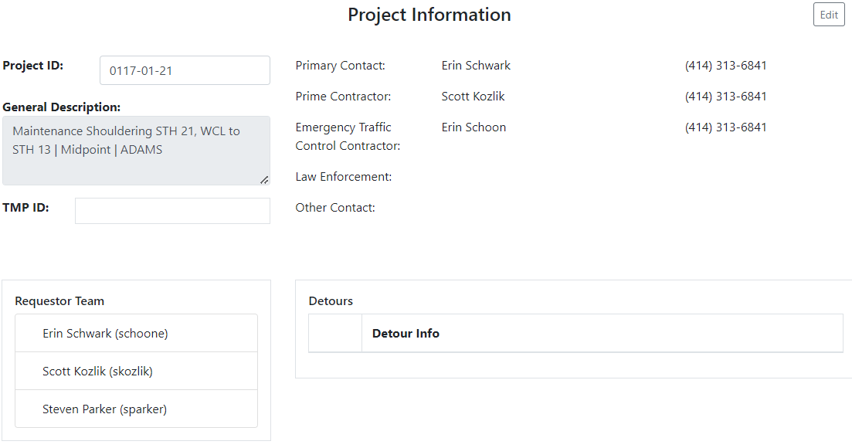
How to find a Project in LCS
Project information is auto-populated but can be edited
TMP ID cannot be edited
If project is not in LCS, contact TOPS Lab to get the project added.
Notes:
Before you can request a closure for a project, you will need to make sure the Project ID is in the system. Go to the projects tab, enter the project ID. If the project is in the system, you will see the project information, which should automatically populate the description and TMP ID. You can then fill in the primary contact, prime contractor and emergency traffic control contractor.
If the project ID is not in the system, the Requestor can fill out a form and submit in order for the project to be added to the system.

Slide 16
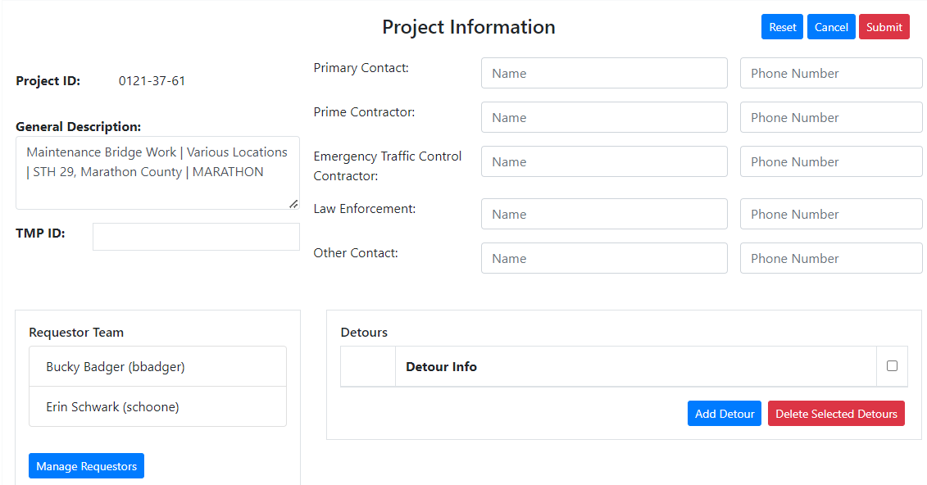
How to set-up a Project
Detour Routes
Allowable Hours
Requestor Team
Notes:
When you are setting up a project, you can add detour routes, allowable hours and the Requestor Team. If your project may have more than one person requesting closures, for instance if someone will be on vacation and another person will be assisting in your absence, you can add that person to the requestor team. Anyone on the requestor team can request, edit or submit a closure.

Slide 17
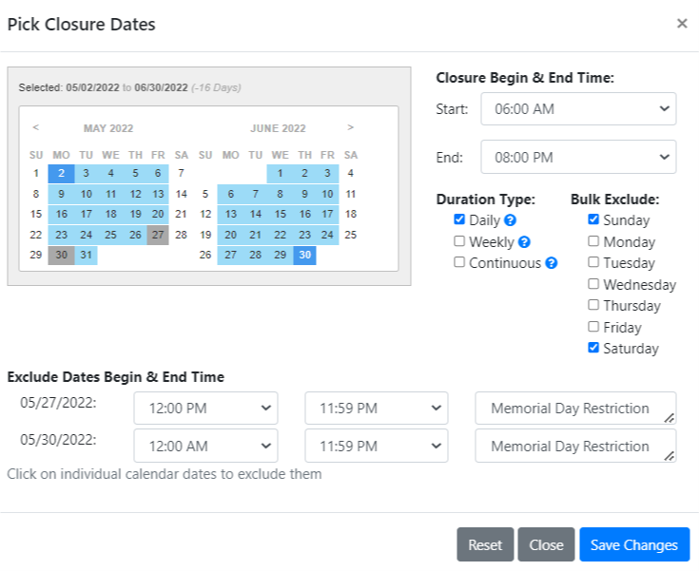
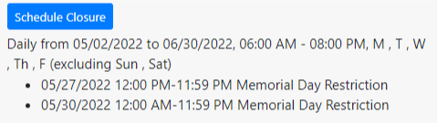
Allowable Hours
Allowable hours are entered so future closure requests can be automatically accepted if request is within the approved hours and no conflicting closures/events within a 3-mile buffer
Allowable hours for a project can be set up within the Projects Tab.
This information should be completed ahead of time before requesting a closure
Allowable hours are when work can take place per contract special provisions.
The Regional Manager then approves the hours for future auto-acceptance
Notes:
The allowable hours are the hours when work can take place, per the contract special provisions. So you can add dates/times when a single lane can be closed, when two lanes can be closed, etc. The regional manger will then be able to approve the hours and any future closure request will be automatically accepted if the request is within the approved allowed hours and there are not any other conflicting closures within a 3 mile buffer.

Slide 18
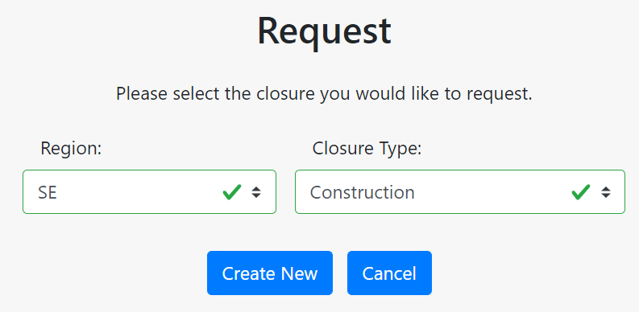
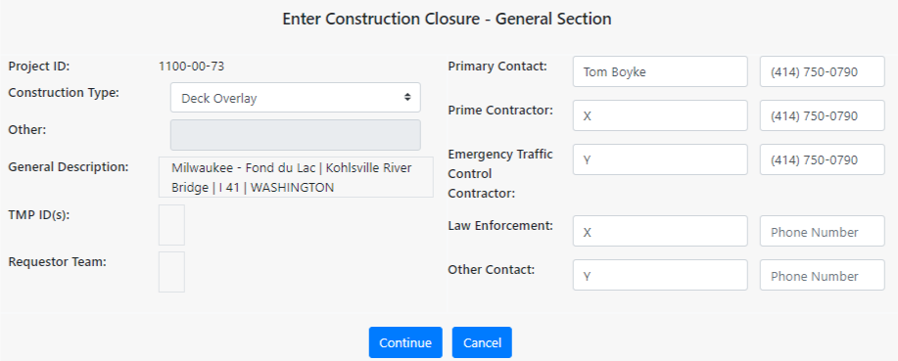
Requesting a Construction Closure
Go to Request Tab
Select Region & Closure Type
Select Project ID
Notes:
Requesting a Construction Closure.
1. Go to the Request tab
2. Select Region & Closure Type
3. Select Project ID

Slide 19
Work Types - Construction
Barrier Wall Work
Beam Launching/Setting
Bridge Sealing
Bridge Work
Cable Guard Work
Clearing & Grubbing
Crack Fill
Crossover Construction
Culvert Work
Curb ramp replacement/installation
Deck Overlay
Deck Replacement
Equipment Mobilization
Erosion Control
Grading
Guard Rail Work
Inlet Work
Interchange Reconstruction
Intersection Reconstruction
Joint Work
Lighting Work
Milling Operation
Patching
Pavement Marking Work
Pavement Work
Paving Operation
Railroad Work
Reconstruction
Restoration
Roadway Widening
Sanitary Sewer Work
Shoulder Work
Sign Installation
Sign Base Installation
Signal Base Installation
Soil Boring
Survey Work
Temporary Widening
Traffic Staging
Utility Work
Water Main Work
Other
Notes:
These are the different construction work types that can be selected from the drop down list. You can only select one, so pick the type that will have the most work done.

Slide 20
Maintenance Project Closure
Is this maintenance type work on an Interstate, US or State highway requested by the state/county/local agency?
  YES: Go to the Request Tab and start entering the closure.
  NO: Determine what type of project this is.
  If it is a construction or permit project, enter as one of those.
Notes:
Is this maintenance type work on an Interstate, US or State highway requested by the state/county/local agency?
YES: Go to the Request Tab and start entering the closure.
NO: Determine what type of project this is.
If it is a construction or permit project, enter as one of those.

Slide 21
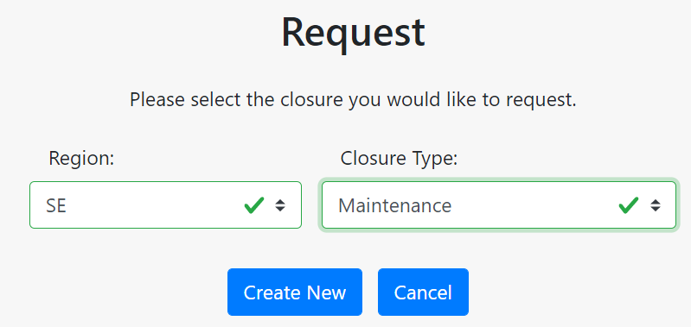
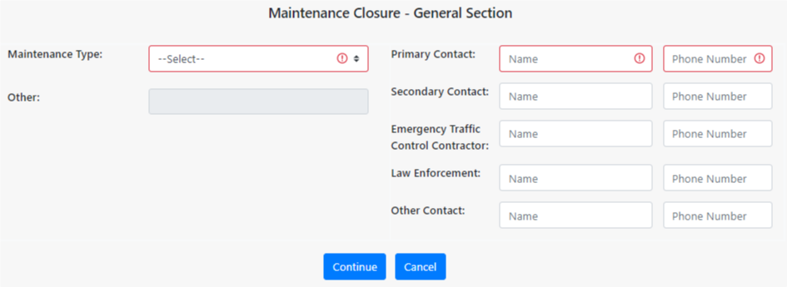
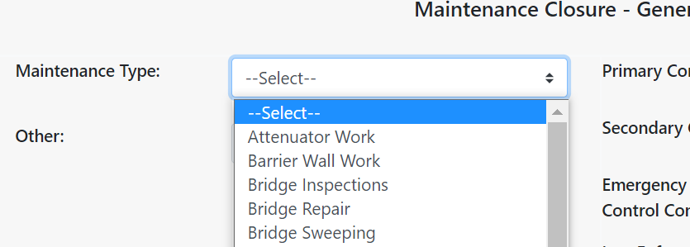
Requesting a Maintenance Closure
Go to Request Tab
Select Region & Closure Type
Select Maintenance Type
Notes:
When requesting a maintenance closure, After you are logged in, you will go to the request tab, select the region and closure type as maintenance. You will then be taken to the general section of closure where you are required to fill out the maintenance type and primary contact. The maintenance types are for the general work you will be doing.

Slide 22
Work Types - Maintenance
Attenuator Work
ATR Maintenance
Barrier Wall Sweeping
Barrier Wall Work
Bridge Deck Sealing
Bridge Inspections
Bridge Repair
Bridge Sweeping
Bridge Washing
Bridge Work
Bump Grinding
Cable Guard Work
Clearing, Grubbing & Tree Removal
Crack Fill
Crash/Spill Cleanup
Culvert Work
Curb Work
Delayed Recovery
Ditch Work
Drainage Work
Drift Control Establishment Activities
Fence Work
Guard Rail Work
Hazmat
ITS Work
Inlet Work
Install Footings for Type 1 Sign
Joint Work
Lighting Work
Merrimac Ferry Maintenance
Milling
Mowing
Paint Testing
Patching Work
Pavement Coring
Pavement Markings
Pavement Repair
(Concrete or Asphalt)
Paving
Poly/Mud Jacking
Prescribed Burn
Railroad Work
Ramp Gate/Ramp Meter Work
Retaining Wall Repair
Shoulder Work
Sign/Sign Bridge Inspection
Sign Installation
Sign Removal
SIS Logo Installation
SIS Logo Removal
Snow Removal
Soil Boring
Sound Wall Repair
Surveying
Sweeping
Traffic Signal Work
Washing (Tunnels, Bridge Decks)
Water Main Work
Other
Notes:
This shows the different types of maintenance work. Select the type of work you will be doing the most of.

Slide 23
Permit Project Closure
Do you have a permit number for this work?
  YES: Go to the Request Tab and start entering the closure.
  NO: Determine what type of project this is.
  If it is a construction or maintenance project, enter as one of those.
Notes:
Do you have a permit number for this work?
YES: Go to the Request Tab and start entering the closure.
NO: Determine what type of project this is.
If it is a construction or maintenance project, enter as one of those.

Slide 24
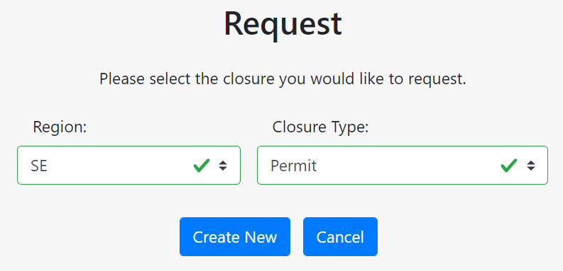
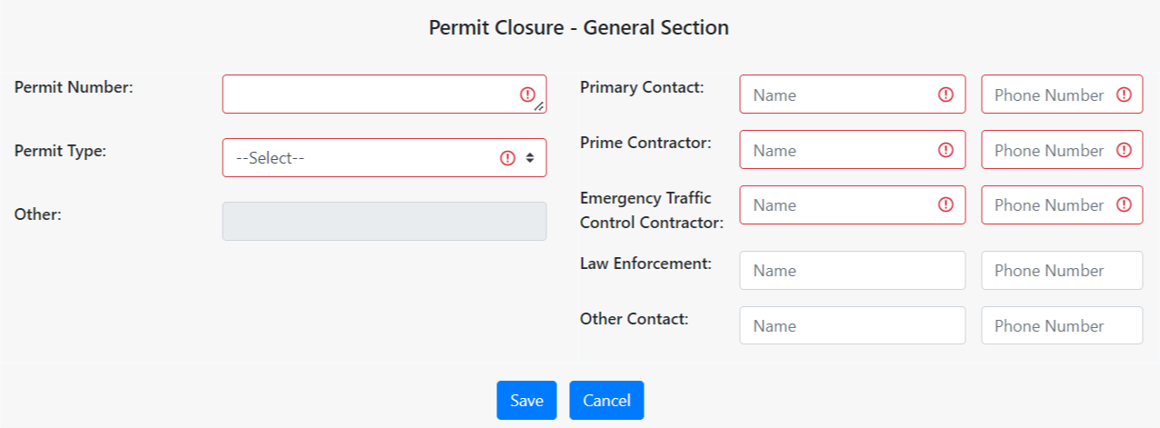
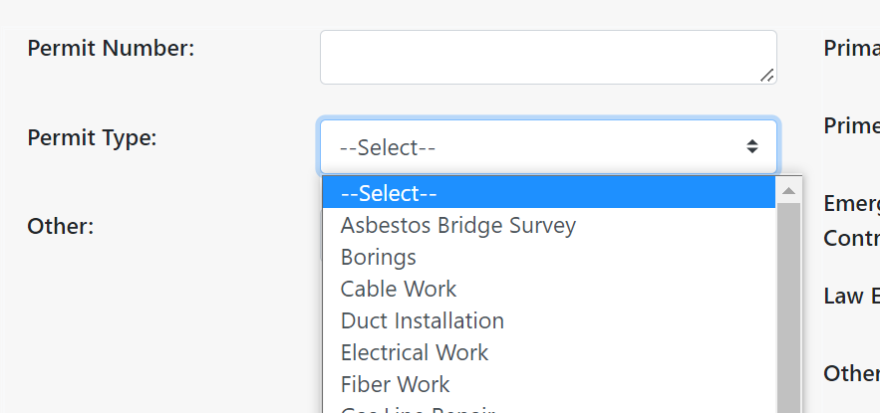
Requesting a Permit Closure
Go to Request Tab
Select Region & Closure Type
Select Permit Number & Type
Notes:
When requesting a permit closure, After you are logged in, you will go to the request tab, select the region and closure type of permit. You will then be taken to the general section of closure where you are required to fill out the permit number, permit type, primary contact, prime contractor and emergency traffic control contractor. The permit types are for the general work you will be doing. Select the type of work you will be doing the most of.

Slide 25
Work Types – Permit
Asbestos Bridge Survey
Borings
Cable Work
Duct Installation
Electrical Work
Fiber Work
Gas Line Repair
Gas Main Work
Grading
Infrared Thermography
Lighting Install/Replacement
Overhead Sign
Pavement Work
Paving
Railroad Crossing
Rare Species Survey
Road Construction
Sanitary Work
Sign Installation
Signal Installation
Storm Sewer Work
Surveying
Trenching
Utility Work
Water Main Work
Wetland Delineation
Other
Notes:
This highlights the different types of permit work.

Slide 26
Special Event Closure
Do you have a permit number for this work?
  YES: Go to the Request Tab and start entering the closure.
  NO: Determine what type of project this is.
  If it is a construction or maintenance project, enter as one of those.
Notes:
Do you have a permit number for this work?
YES: Go to the Request Tab and start entering the closure.
NO: Determine what type of project this is.
If it is a construction or maintenance project, enter as one of those.

Slide 27
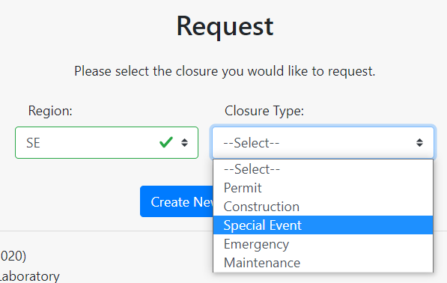
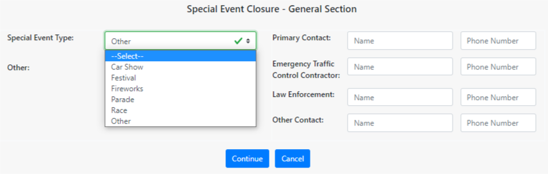
Requesting a Special Event Closure
Car Show
Festival
Fireworks
Parade
Procession
Race/Run
Street Fair/Event
Other
Go to Request Tab
Select Region & Closure Type
Select Special Event Type
Notes:
For special event closures, it is similar to the permit closure process, but select Special Event

Slide 28
Emergency Closure
Does the roadway need to be closed because it is an immediate hazard to the traveling public?
  YES: Go to the Request Tab and start entering the closure.
  NO: Determine what type of project this is.
  Work with your Regional Manager to determine how to best enter
  the closure.
Notes:
For an emergency closure, Does the roadway need to be closed because it is an immediate hazard to the traveling public?
YES: Go to the Request Tab and start entering the closure.
NO: Determine what type of project this is.
Work with your Regional Manager to determine how to best enter the closure.

Slide 29
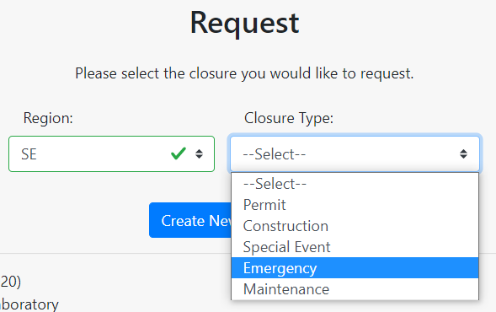
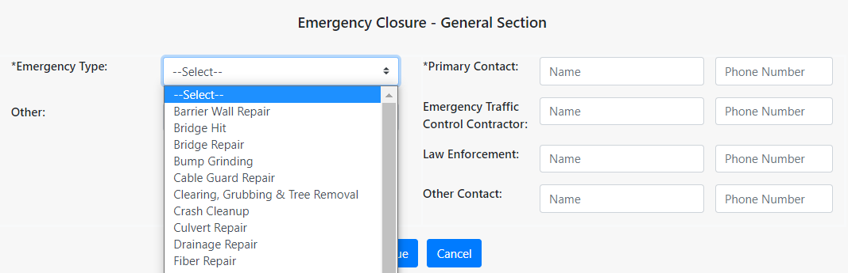
Requesting an Emergency Closure
Go to Request Tab
Select Region & Closure Type
Select Emergency Type
Notes:
If you have the proper access to enter emergency closures, follow the same request process as previously mentioned.

Slide 30
Work Types - Emergency
Barrier Wall Repair
Bridge Hit
Bridge Repair
Bump Grinding
Cable Guard Repair
Clearing, Grubbing & Tree Removal
Crash Cleanup
Crash Drum Repair
Culvert Repair
Drainage Repair
Fiber Repair
Flooding
Gas Main Repair
Guard Rail Repair
ITS Repair
Lighting Repair
Patch Work
Pavement Buckle
Pavement Heave Repair
Pavement Marking Repair
Pavement Repair
Railroad Crossing Repair
Sewer Repair
Shoulder Repair
Sink Hole
Traffic Signal Repair
Utility Service Repair
Washout Repair
Water Main Repair
Other
Notes:
This shows the different types of emergency closures. If you have the emergency access flag, you will have the option to enter an emergency closure.

Slide 31
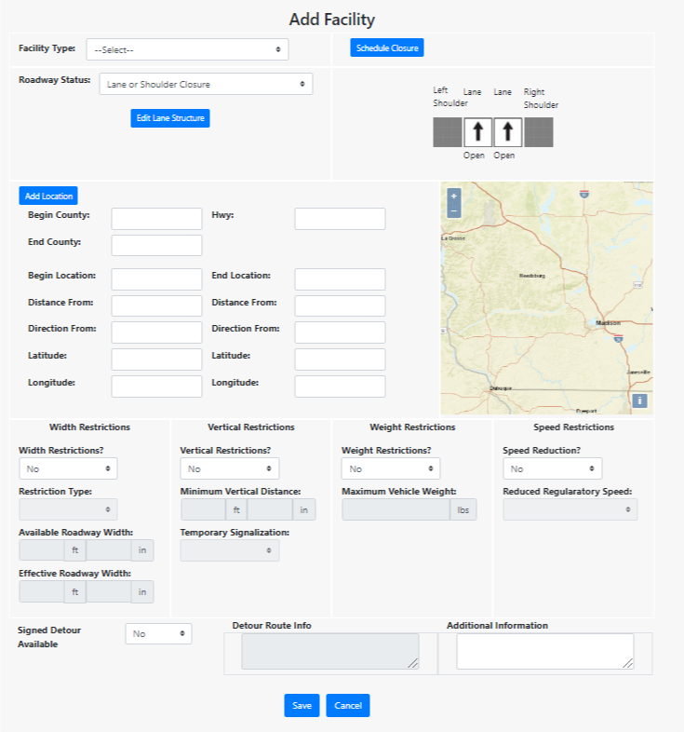
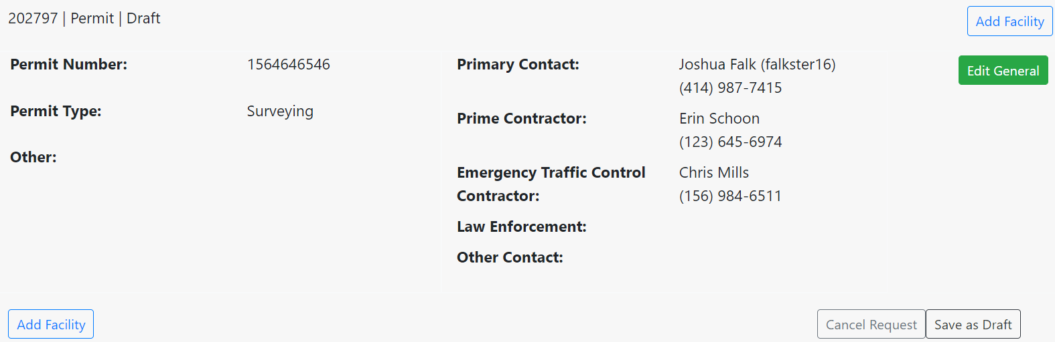
Requesting a Closure
Select the facility type
Enter the schedule information
Enter the roadway status and/or fill out the lane diagram information
Enter the highway location information
Enter restrictions and/or detour routes limit
Notes:
After you fill out the general section of the request, you can then add a facility to start adding the details of the closure which will bring you to the add facility page. Here you will select the facility type, schedule information, roadway status/lane diagram, highway location and then any restrictions or detour routes.

Slide 32
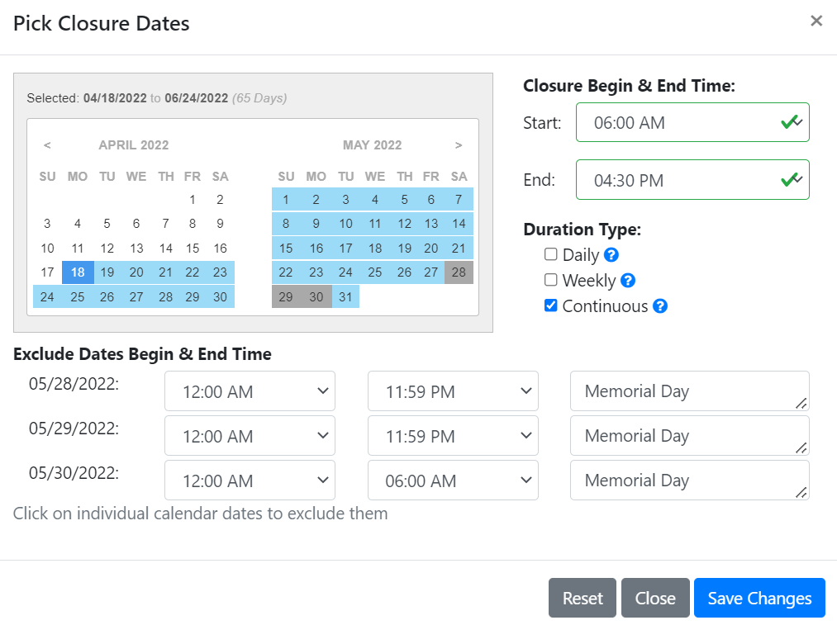
Requesting a Closure
Closure Duration Types
  Daily - occurs on a recurring daily or nightly basis. The closure is active for only part of each day.
  Weekly - typically a few days per week, but on a recurring basis.
  Continuous - a 24-hour work zone typically lasting more than one week, starting on the Begin Date and Time, and ending on the End Date and Time.
Notes:
There are three types of closure durations
-A daily closure occurs on a recurring daily or nightly basis. The closure is active for only part of each day.
- A weekly closure is typically a few days per week, but on a recurring basis.
-A continuous closure is a 24-hour work zone typically lasting more than one week, starting on the Begin Date and Time, and ending on the End Date and Time.

Slide 33
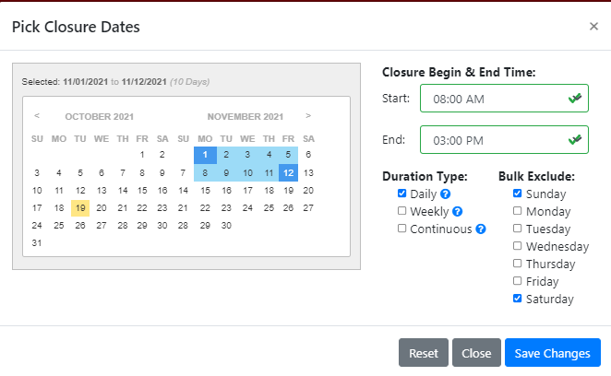
Requesting a Closure
Daily Closure Duration Example
  Monday, November 1 to Friday, November 12, from 8am to 3pm each day.
  The cones are dropped at 8am and picked up again at 3pm each day the closure is
  active.
  If the daily closure was not to be active on Saturdays, one would check Saturday under Bulk Exclude. This will deselect all
  Saturdays between the start and end dates
  on the calendar.
  Multiple Exclude Dates are allowed.
Notes:
The following is a Daily Closure Duration Example
Monday, November 1 to Friday, November 12, from 8am to 3pm each day.
The cones are dropped at 8am and picked up again at 3pm each day the closure is
active.
If the daily closure was not to be active on Saturdays, one would check Saturday under Bulk Exclude. This will deselect all
Saturdays between the start and end dates
on the calendar.
Multiple Exclude Dates are allowed.

Slide 34
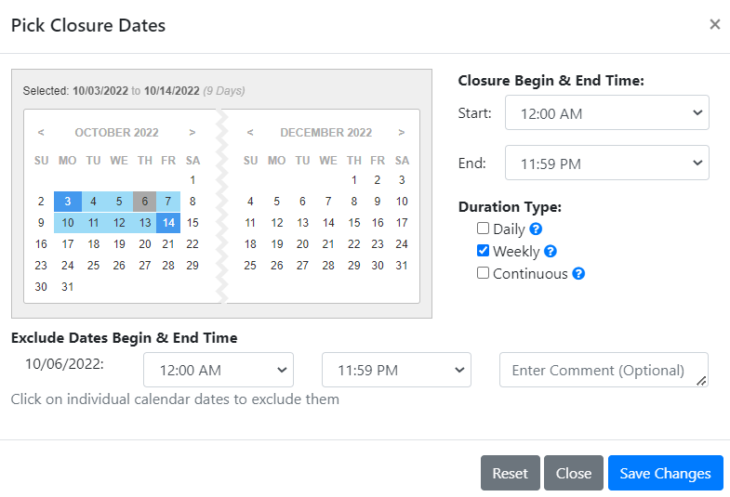
Requesting a Closure
Weekly Closure Duration Example
  A Monday ‐ Friday closure for 4 weeks, from 8am Monday to 3pm Friday.
  The cones would be dropped every Monday at 8am, and picked up every Friday at 3pm, each week the closure is active.
  The calendar will automatically deselect Saturdays and Sundays.
  Exclude Dates: if the closure will not be active
  on a particular day within the date range,
  clicking on the date on the calendar will
  deselect it, indicating a single Exclude Date.
  Multiple Exclude Dates are allowed.
Notes:
The following is a Weekly Closure Duration Example
Work will occur for 4 weeks, from 8am Monday to 3pm Friday.
The cones would be dropped every Monday at 8am, and picked up every Friday at 3pm, each week the closure is active.
The calendar will automatically deselect Saturdays and Sundays.
For Exclude Dates: if the closure will not be active on a particular day within the date range, clicking on the date on the calendar will deselect it, indicating a single Exclude Date. This example shows Thursday the 6th as an excluded date.
Multiple Exclude Dates are allowed.

Slide 35
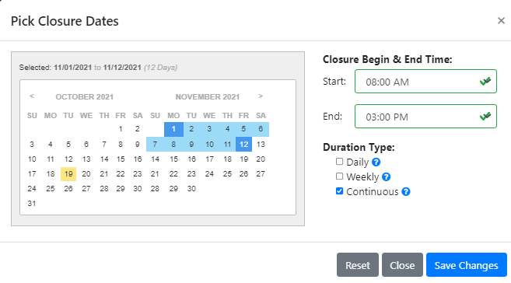
Requesting a Closure
Continuous Closure Duration Example
  Monday, November 1 at 9:00am to Friday, November 12 at 3:00pm
  The cones are dropped at 9am on November 1 and picked up at 3pm on November 12.
  Exclude Dates: if the closure will not be active on a particular day within the date range, clicking on the date on the calendar will deselect it, indicating a single Exclude Date.
  Multiple Exclude Dates are allowed.
Notes:
The following is a Continuous Closure Duration Example
Work will occur on Monday, November 1 at 9:00am to Friday, November 12 at 3:00pm
The cones are dropped at 9am on November 1 and picked up at 3pm November 12.
Exclude Dates: if the closure will not be active on a particular day within the date range, clicking on the date on the calendar will deselect it, indicating a single Exclude Date.
Multiple Exclude Dates are allowed.

Slide 36
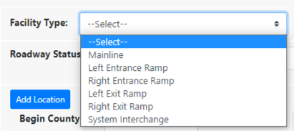
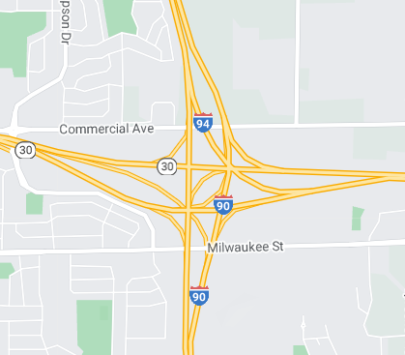
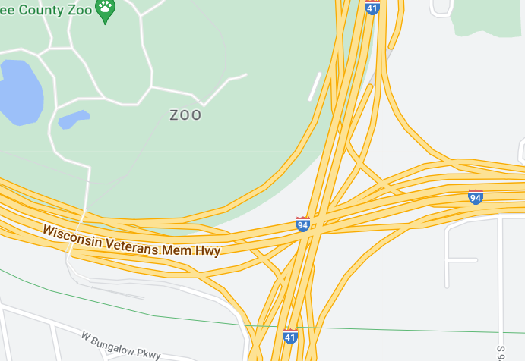
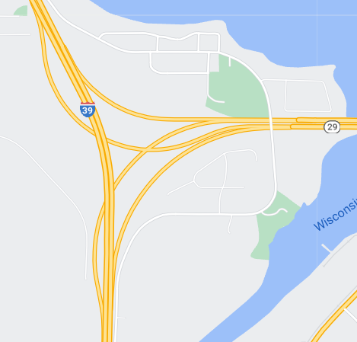
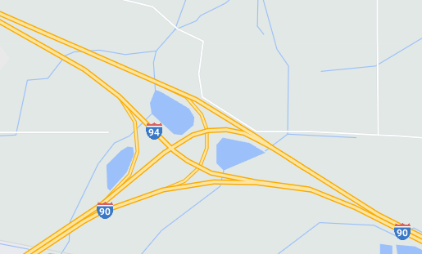
Requesting a Closure
Facility Type
  Mainline – linear closure
  Left/Right Entrance Ramp – point closure
  Left/Right Exit Ramp – point closure
  System Interchange – point closure
    A system interchange is any free flow ramp from one major highway to another major highway. See examples below:
Notes:
After the closure hours are entered, you can then select the facility type and roadway status. The facility types are mainline, left/right entrance ramps, left/right exit ramps and system interchange.

Slide 37
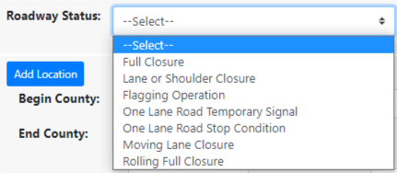
Requesting a Closure
Roadway Status
  Full Closure – used when all lanes and shoulders are closed in
  one direction or both directions
  Lane or Shoulder Closure – used when there is a lane or
  shoulder closure.
  Flagging Operation – used when flaggers are used during work zone operations.
  One Lane Road Temporary Signal – used when a temporary signal is being used for one lane bridge work or other scenarios.
  One Lane Road Stop Condition – used for short work zones with low volumes where the driver can see the oncoming traffic and stops before proceeding.
  Moving Lane Closure – used when a work crew will be moving down the roadway to perform such work as pothole patching, pavement marking painting, etc.
  Rolling Full Closure – used when the work temporarily pauses all lanes of traffic for less than 15 minutes such as for bridge girder setting, equipment moves, and sign structure replacement, and law enforcement is used to help control traffic.
Notes:
Full Closure – user must create a Full Closure in one direction,
then replicate the facility in the opposite direction, in order to
show that both directions are closed, if that’s the situation.
Lane or Shoulder Closure – used when there is a lane or
shoulder closure.
Flagging Operation – used when flaggers are used during work zone operations.
One Lane Road Temporary Signal – used when a temporary signal is being used for one lane bridge work or other scenarios.
One Lane Road Stop Condition – used for short work zones with low volumes where the driver can see the oncoming traffic and yields before proceeding.
Moving Lane Closure – used when a work crew will be moving down the roadway to perform such work as pothole patching, pavement marking painting, etc.
Rolling Full Closure – used when the work temporarily pauses all lanes of traffic for less than 15 minutes such as for bridge girder setting, equipment moves, and sign structure replacement, and law enforcement is used to help control traffic.

Slide 38

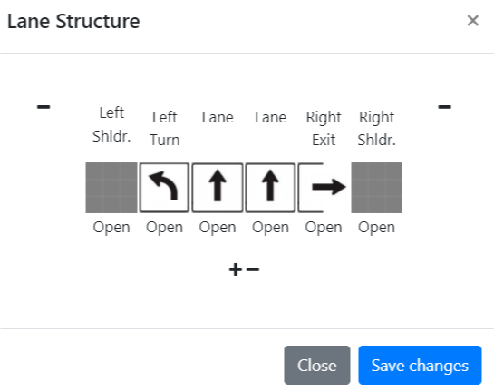
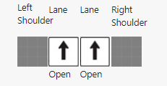
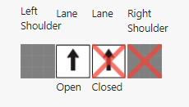
Lane Structure Diagram
If Lane or Shoulder Closure is selected
  Click Edit Lane Structure button
  Select lanes that will be closed
    Click on +/- to add/remove lanes in diagram
    Click on each arrow to switch to shift, left/right turn, or left/right exit
      Left/right exit lanes used when there is an auxiliary lane
The following slides show examples of closure diagram scenarios
Notes:
If you select lane or shoulder closure, you will need to edit the lane diagram and select the lanes you are closing, and which ones will remain open. You can click on each arrow, and it will switch to shift, left/right turn lane or left/right turn exit. Once you have created your lane set-up, click save and you can then click on the boxes to either close or shift the lanes.

Slide 39
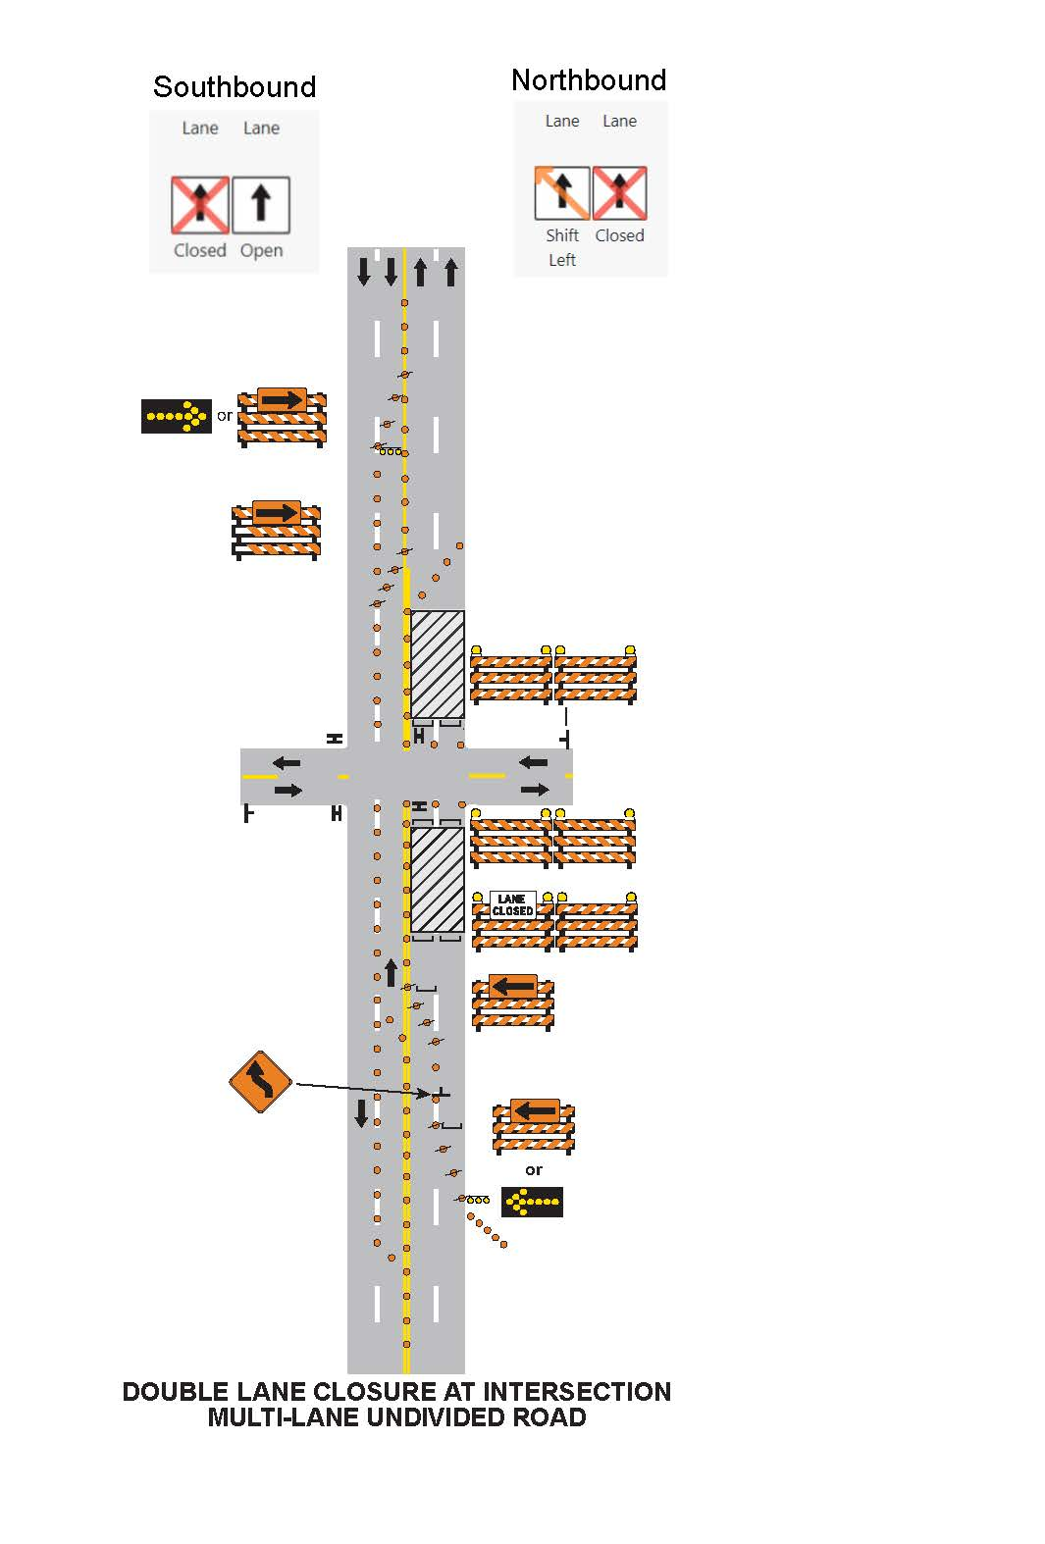
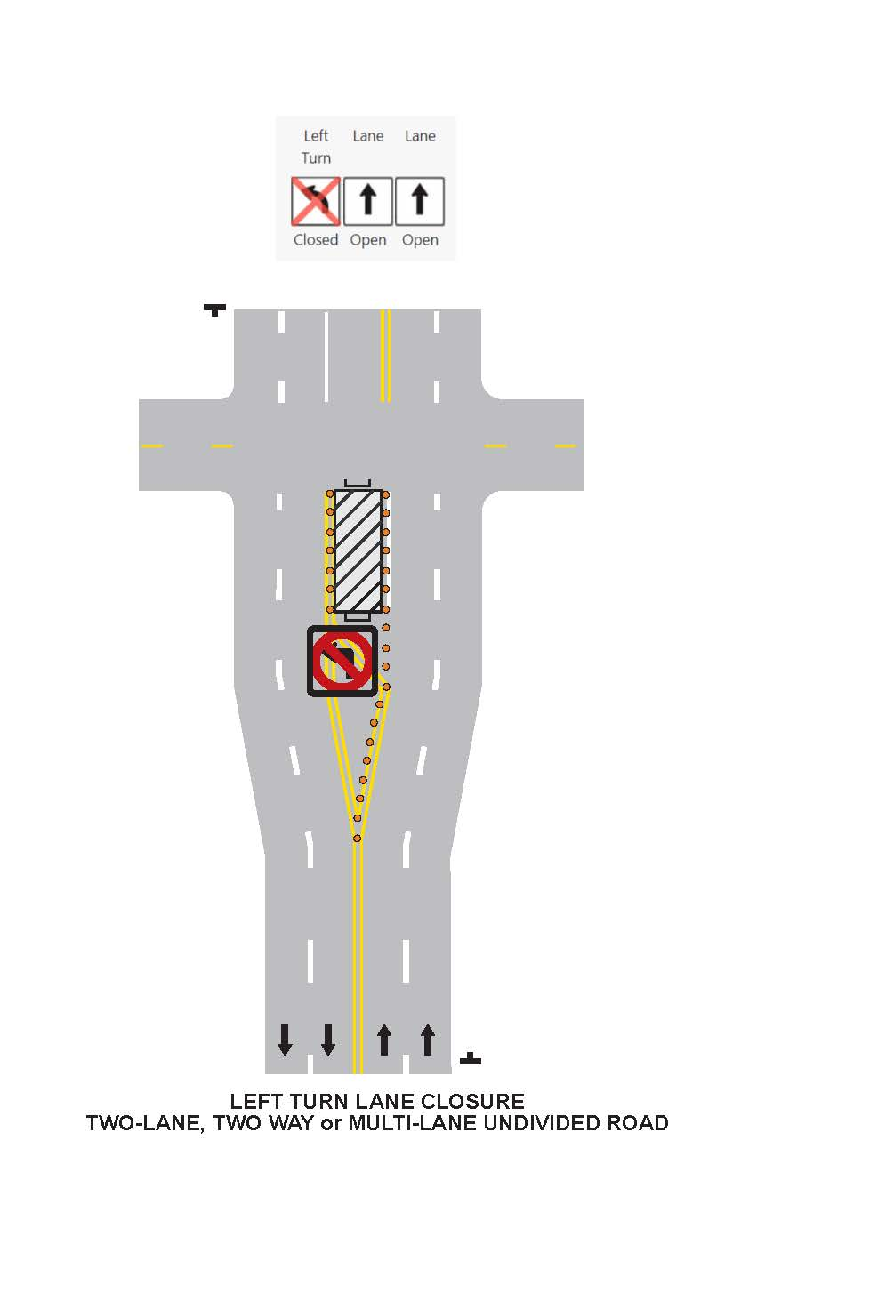
Example #1
Intersections
Example #2
Notes:
The following slides are examples of lane closure structure diagrams.

Slide 40
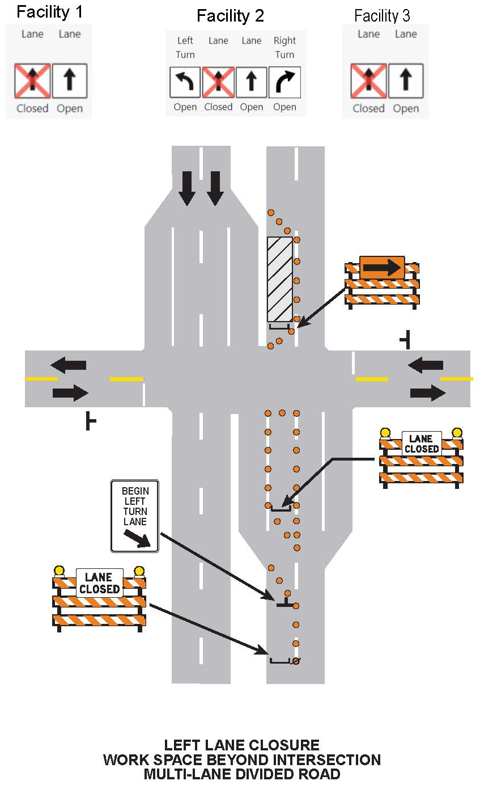
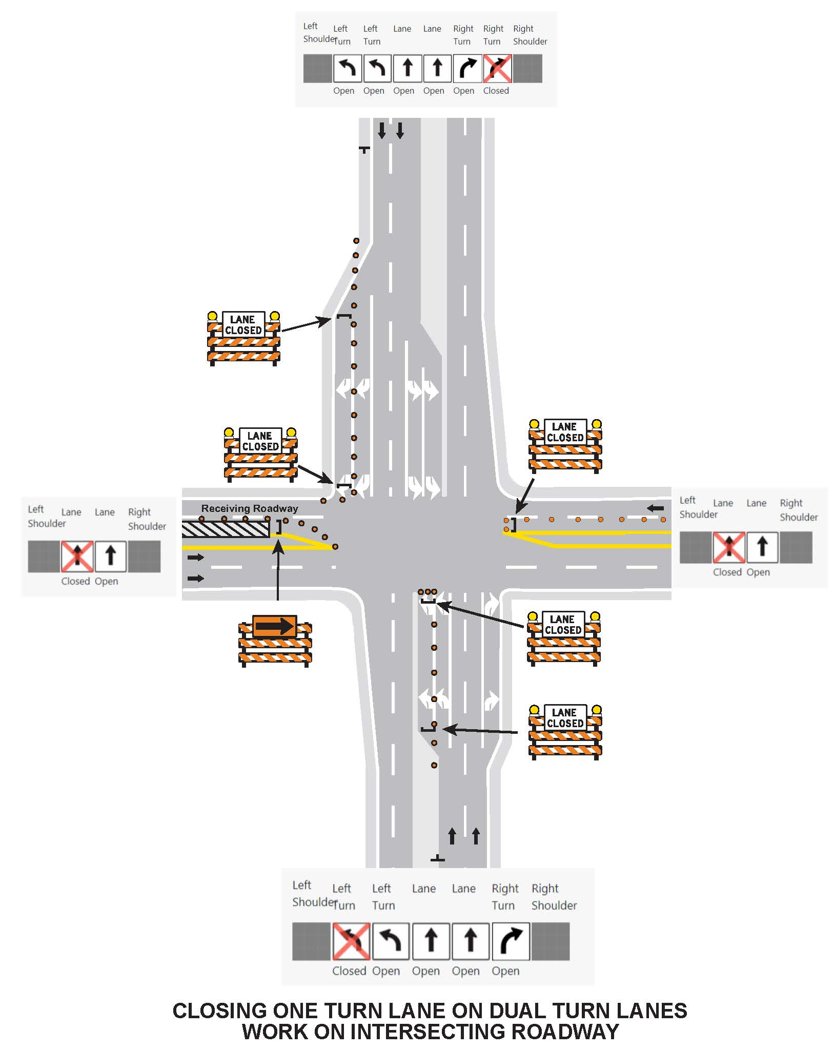
Example #3
Example #4
Facility 3
Facility 2
Facility 1

Slide 41
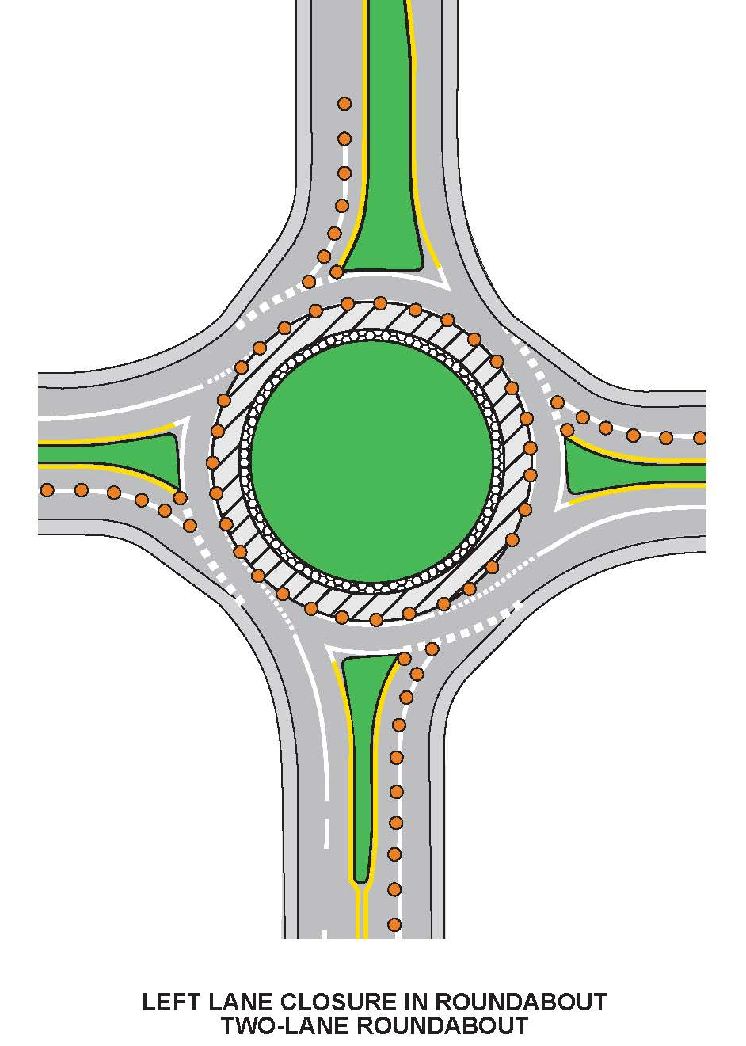
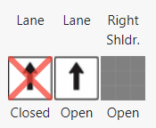
For all approaches
Example #5

Slide 42
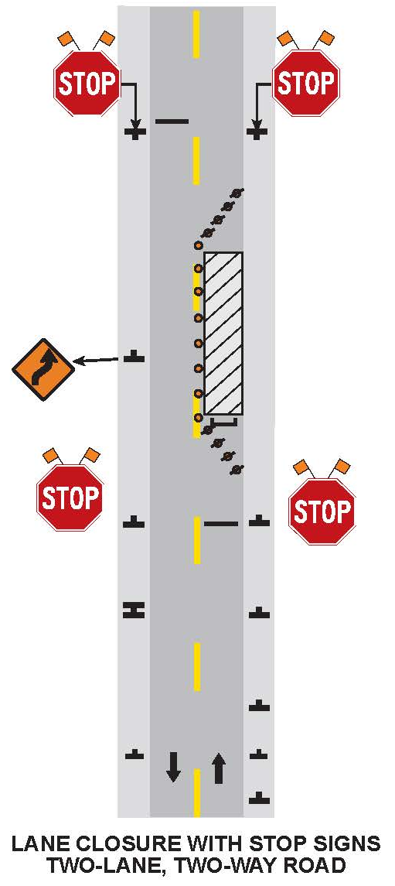
Example #6
One Lane Road Stop Condition
Notes:
For example 6, you do not use the lane or shoulder closure status, instead you choose one lane road stop condition so a lane diagram is not needed in this case.

Slide 43
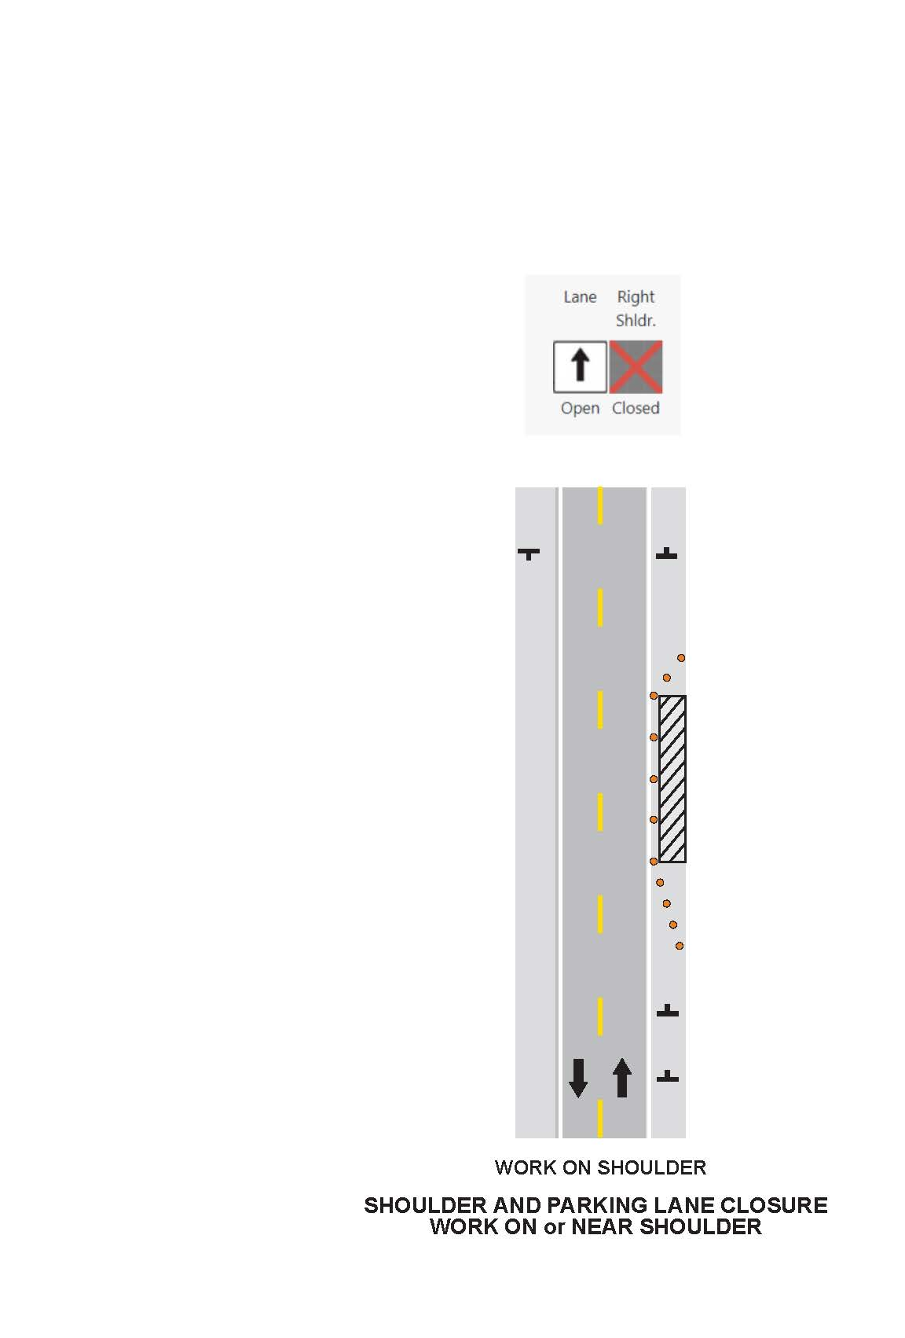
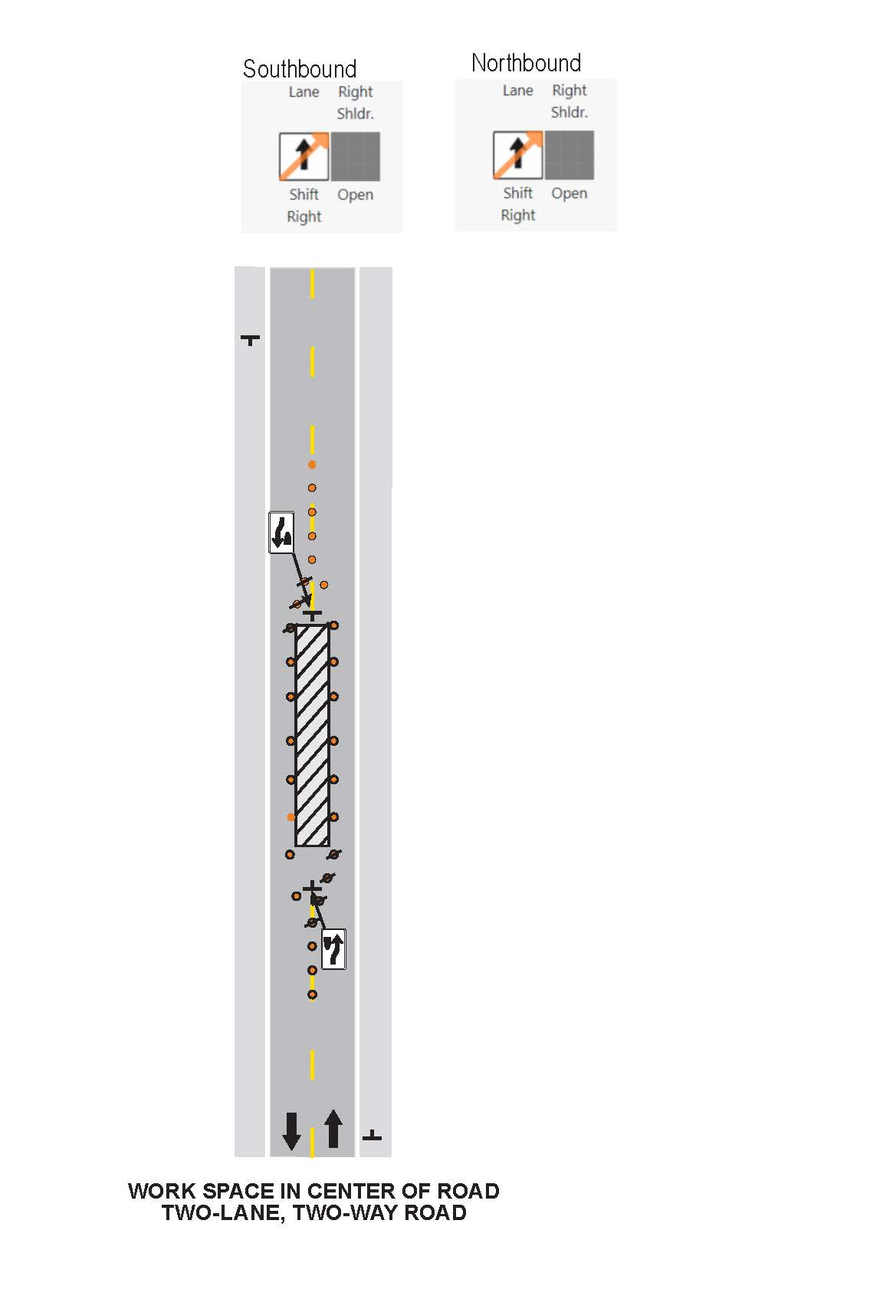
Example #7
Example #8

Slide 44
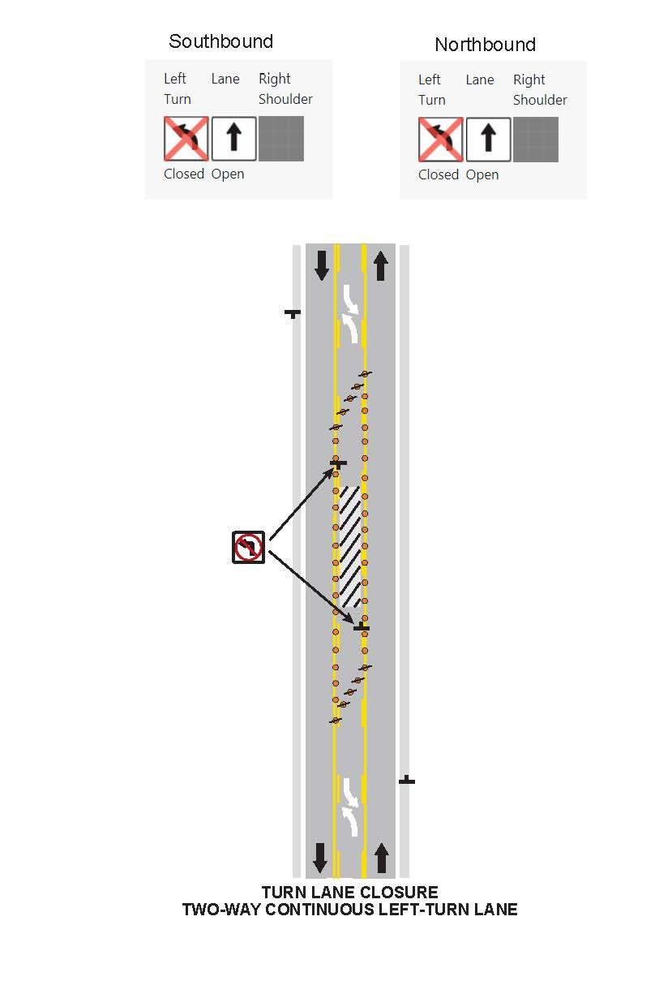

Example #9
Example #10

Slide 45



Example #12
Example #11

Slide 46

Various Lanes Closed
  “Various times closed” checkbox should only be checked if user does not know what time the lane closures will occur.
Notes:
“Various times closed” checkbox should only be checked if user does not know what time the lane closures will occur.

Slide 47


Mapping the Closure
Enter in the fields or click on the map
B - Zoom to Begin Marker
E - Zoom to End Marker
BE - Zoom to Both Begin & End Marker
H - Zoom to Highway
Notes:
This is an example of how you would add a location via the map. You would click on the add location button, which would take you to this page. You can enter the begin county, the end county will auto-populate, then you can select your highway and direction and the map will zoom to that county/highway. You can then go to the map to select your start and end location if it is a mainline closure. If you click on the H it will zoom to that highway. When you click to add your start or end, a list of the 3 nearest landmarks will appear so you can select the one that best fits.

Slide 48



Lane Detail Scenarios
Entrance Ramp
  Right lane and
  shoulder closed
  Select the choice with the correct from and to highway listed
    Ex: on WIS 19 going to I-39
  If entering from a non-state highway, select the highway entering in order for the correct “from” landmarks to be selected
    Ex: on County F going to I-94
Notes:
This is an example for an entrance ramp closure. For ramps, they are point closures and only ramps will appear in the landmark list. Select the choice with the correct from and to highway listed. This first example shows that you are going from WB WIS 19 to Interstate 39 NB.
When entering a highway from a county or local road, first select the highway you are entering, then the appropriate landmarks will show up. Select the proper on ramp landmark.

Slide 49


Lane Detail Scenarios
Exit Ramp
  Right shoulder closure with lane shift
Notes:
This is an example for an exit ramp closure. Similar to an entrance ramp, these are point closures and only ramps will appear in the landmark list.

Slide 50



System Interchange
Example:
  Close I-94 WB (I-43 NB/I-94 WB to I-94 WB)
    Drop marker at the beginning of the leg of the interchange & choose that landmark in the marker list and it will populate items on the left.
    Landmarks listed should be interchange landmarks
Notes:
Similar to ramps, system interchanges are only point closures as well and only system ramps will show in the landmark list. We have simplified the landmarks for the system interchanges to include the system ramp that exits the freeway, instead of a landmark for exiting and entering the mainline.

Slide 51

Entering Detour Routes
Type free text into cell
Multiple detour routes can be added and entered
For full closures, detour information is required
Example of Detour Info input
Signed detour route follows:
US 61/WIS 35, between south of Lancaster and Dickeyville
US 151, between Dickeyville and Platteville
WIS 80/WIS 81 within Platteville
Notes:
If you have a signed detour route, you can enter the information in the detour info location. If your project will have different lane closures, you can enter them all in and when you request a closure they will be saved and you can just select from the list which detour route should be assigned with that closure.
If this is a construction project and there is a planned detour route already entered into the projects tab, you can select an already created detour.
For full closures, detours are required.

Slide 52


Replicating Facilities
Take an existing closure & facility and click Replicate
As-Is copies the facility exactly and user can adjust
In-Opposite-Direction changes the direction to other side of roadway. User should confirm the location and landmarks are good. User can adjust afterwards
Notes:
There is a feature called replicate where you can replicate a facility as-is or in the opposite direction.

Slide 53


Modifying a Closure
Notes:
You can also modify any closure by going to the closure actions and selecting edit.

Slide 54
Copying a Closure
Notes:
Copy Closure is used if you want to copy an exact closure. You would go to the closure actions and select copy closure and then you can edit the closure from there if needed.

Slide 55


Submitting a Closure
Notes:
Once you are all done entering the required information and a facility, you click submit. If you are not ready to submit, you can save the closure as a draft as well. If you are limited approver or full approver, you can select self accept closure and it will be automatically accepted. This option will only show if you have the authorization to do so.

Slide 56

Viewing Closures on Home Page
Notes:
This is a view of the homepage. You will have the capability to filter and sort closures.

Slide 57
Accepting/Rejecting a Closure
***can assign acceptance authority and administrative privileges
Notes:
This table shows the rules of what users can accept or reject closure requests. System managers and regional managers can do everything in the system, like accept and reject closures. System Managers can also assign admin privileges.

Slide 58



Accepting a Closure
Notes:
If you have the proper approval authority, to accept a closure you can click accept or check the self accept closure option. Then you will get a pop-up, are you sure you want to submit and click yes accept and the closure will be accepted.

Slide 59


Completing a Closure
User must “complete” the facility when it is no longer active for it to be removed from the list of closures for closures longer than 14 days.
If “Complete All” is selected, this completes the general closure along with all its facilities.
If the end date needs to be modified, do this prior to the end date, otherwise the closure can be copied into a new request.
Notes:
User must “complete” the facility when it is no longer active for it to be removed from the list of closures for closures longer than 14 days.
If “Complete All” is selected, this completes the general closure along with all its facilities.
If the end date needs to be modified, do this prior to the end date, otherwise the closure can be copied into a new request.

Slide 60



Search
Notes:
The Search page offers any type of project, closure status, location or date to be searched. The results can be viewed by map or table view and a CSV file can be downloaded. You can multi-select closure type or any of the drop downs, search by ID, closure ID or by who entered it.

Slide 61


Notes:
You can view the closure map to see if there are nearby closures that could impact your closure or that would require coordination with adjacent projects. You can change the dates to look ahead. You will see the nearby closures listed, so you can also view those closures as well.

Slide 62
Resources
LCS Homepage
  https://transportal.cee.wisc.edu/closures/
User Manual and Recorded Trainings
LCS Training Site – “sandbox”
  For users to learn, practice and test closures
Technical Support, User Account and Issues Entering Closure Requests
  wislcs@topslab.wisc.edu
Notes:
For more information, including trainings and technical support contacts, visit the Wisconsin Lane Closure System Homepage.

